Slide 1


Algorithmic Approaches for Finding Better QUBO Formulations
Jonas Nüßlein, Sebastian Zielinski, Sebastian Feld, Claudia Linnhoff-Popien
IEEE Quantum Week (IEEE QCE’23)
September 18, 2023

Slide 2
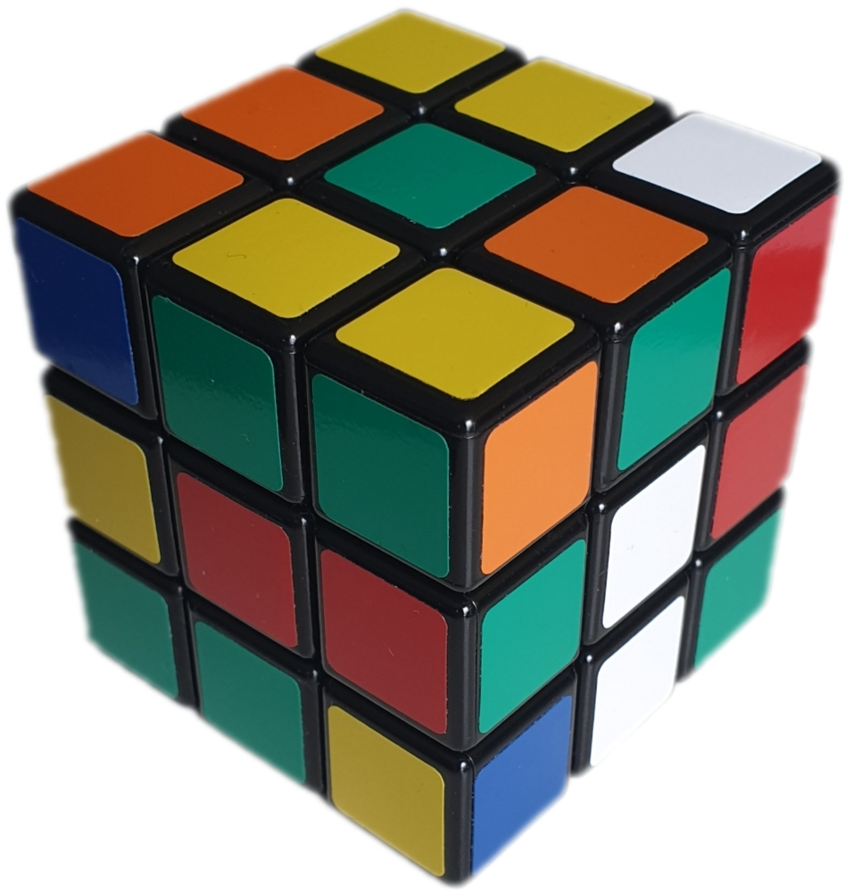
Intuition
upload.wikimedia.org/wikipedia/commons/b/b0/Scrumbled_Rubik%27s_Cube.jpg
arxiv.org/pdf/1811.07403.pdf
upload.wikimedia.org/wikipedia/commons/4/4e/Rubiks_Cube_%2811913013374%29.jpg

Slide 3
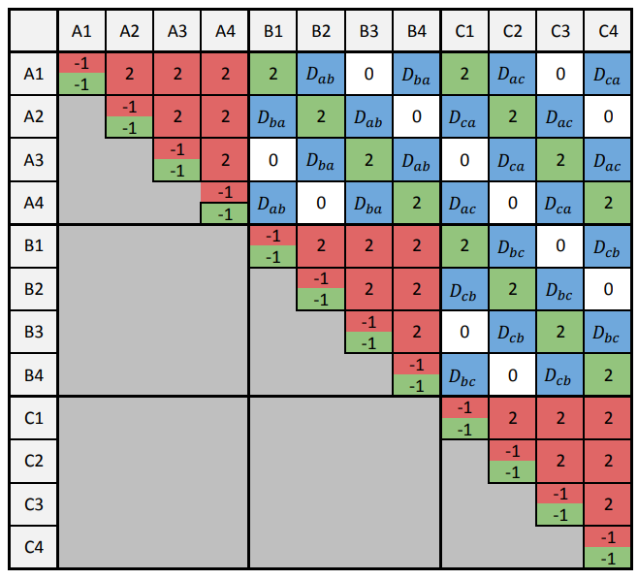
Intuition
upload.wikimedia.org/wikipedia/commons/b/b0/Scrumbled_Rubik%27s_Cube.jpg
arxiv.org/pdf/1811.07403.pdf
upload.wikimedia.org/wikipedia/commons/4/4e/Rubiks_Cube_%2811913013374%29.jpg

Slide 4
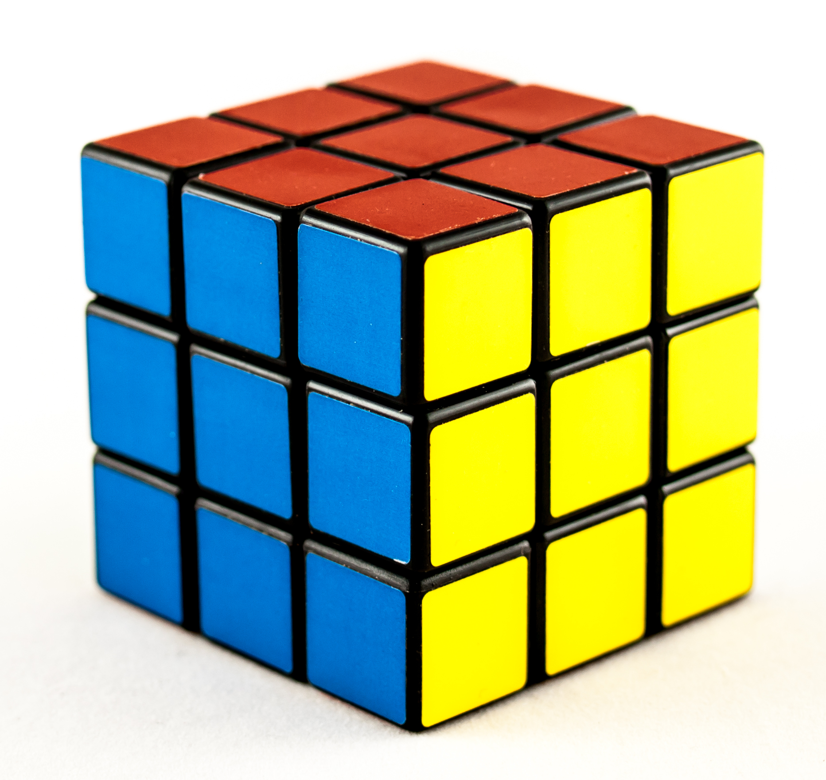
Intuition
upload.wikimedia.org/wikipedia/commons/b/b0/Scrumbled_Rubik%27s_Cube.jpg
arxiv.org/pdf/1811.07403.pdf
upload.wikimedia.org/wikipedia/commons/4/4e/Rubiks_Cube_%2811913013374%29.jpg

Slide 5
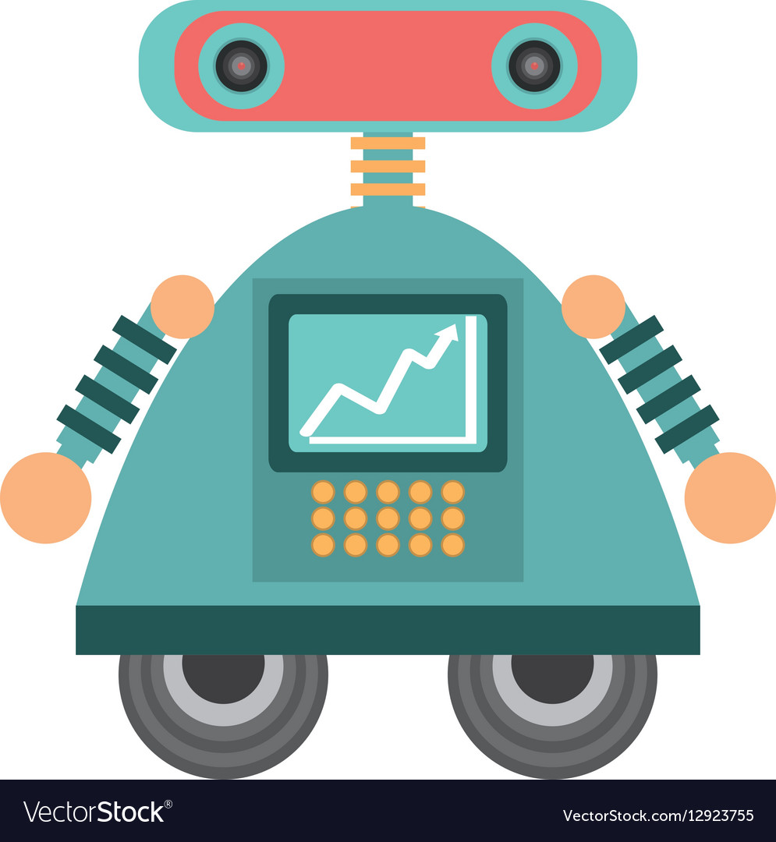
Intuition
upload.wikimedia.org/wikipedia/commons/b/b0/Scrumbled_Rubik%27s_Cube.jpg
vectorstock.com/royalty-free-vector/robot-android-automation-icon-vector-12923755upload.wikimedia.org/wikipedia/commons/4/4e/Rubiks_Cube_%2811913013374%29.jpg

Slide 6

Tutorial goals
searchenginejournal.com/wp-content/uploads/2019/01/top-12-strategic-tactical-seo-goals-to-consider-this-year-5ec4a56581222-760x400.webp
Goal of this tutorial
Introduce and demonstrate innovative methods for the formulation QUBO problems
Motivation behind
Facilitate and automate the process of their formulation
By the end of this tutorial, you…
Will feel confident to apply the presented formulation methods to your own use cases

Slide 7
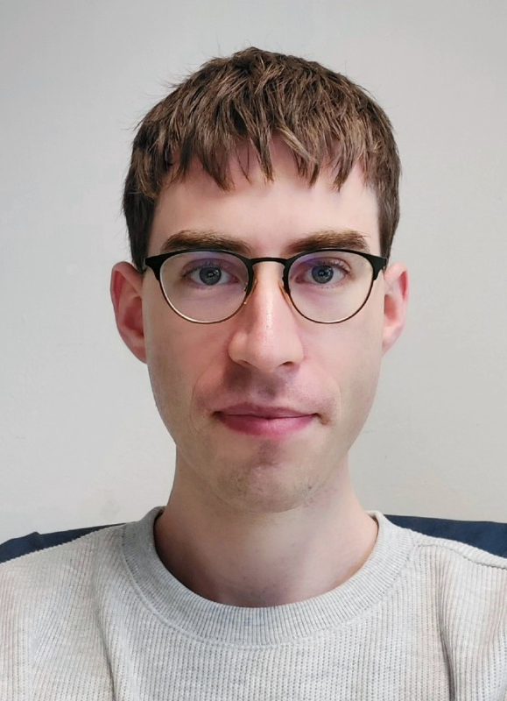

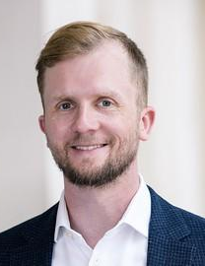
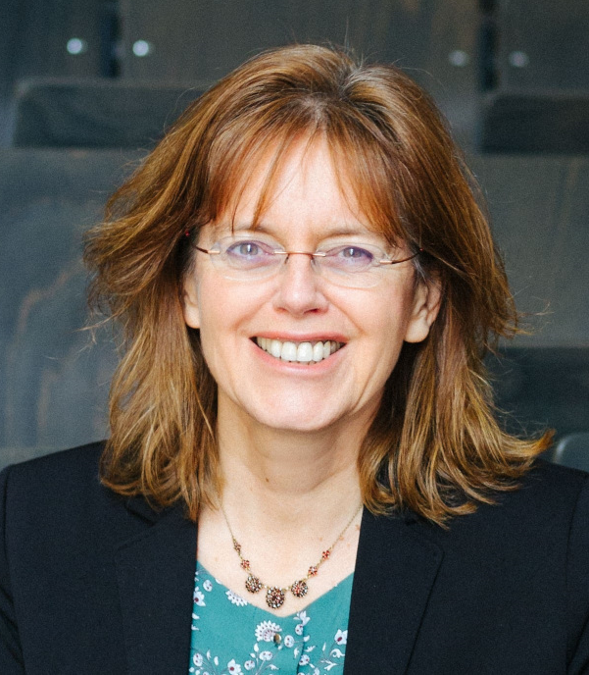
Contents and instructors
Structure
Naïve QUBO formulation
Pattern QUBO
Algorithmic QUBO formulation
Learning QUBOs
Jonas Nüßlein
Sebastian Zielinski
Sebastian Feld
Claudia Linnhoff-Popien
Notes:
Break somewhere in part 3

Slide 8
Enjoy the ride!
Thank you!

